Slide 1
Fault Tolerant CNN

Slide 2
Error Prone CNN Application
Cause of error
Recent literature indicates that soft errors are inevitable in modern systems, from edge computing devices to supercomputers
high-energy cosmic radiation
Aging and wear of devices
CNN inference applications often call for power-efficient and cost-efficient machine learning accelerators, which may adopt overclocking with voltage underscaling, incurring more soft errors than common hardware incurs.

Slide 3
Resilient convolutional neural networks are essential for guaranteeing the correctness of inference applications.
A single bit flip happened during CNN image classification could result in as much as 40% and 70% SDC rate in datapath and memory, respectively.
Such high SDC rates would downgrade the CNN prediction accuracy dramatically.
[SDC Rate: Silent Data Corruption (SDC) Rate]
Existing resilient solutions (ECC) are insufficient for protecting CNN inference applications against multiple soft errors.

Slide 4
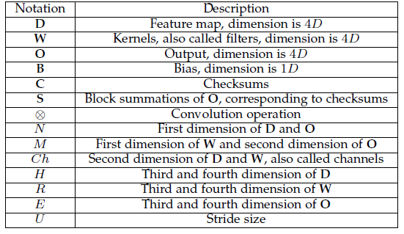
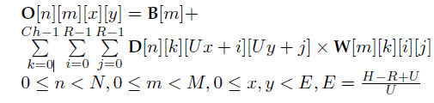

CNN Basics

Slide 5
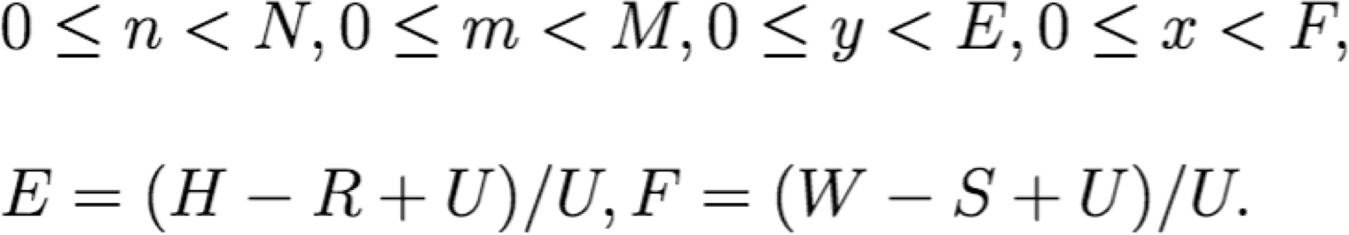
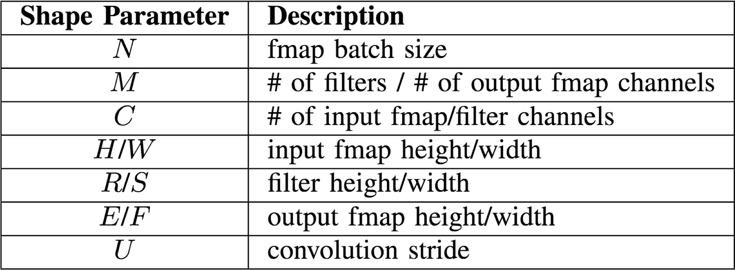
CONV Layer Tensor Computation
Output fmaps (O)
Biases (B)
Input fmaps (I)
Filter weights (W)

Slide 6



Convolution (CONV) Layer
output fmap
an output
input fmap
filter (weights)
H
activation
R
E
S
W
F
Element-wise Multiplication
Partial Sum (psum)
Accumulation

Slide 7

Convolution (CONV) Layer
output fma
an output
input fmap
filter (weights)
activation
H
R
E
S
W
F
Sliding Window Processing

Slide 8
Convolution (CONV) Layer
input fmap
filter
C
…
…
…
output fmap
…
…
C
…
H
…
R
E
…
…
S
W
F
Many Input Channels (C)

Slide 9
Convolution (CONV) Layer
input fmap
many filters (M)
output fmap
…
…
…
C
…
…
C
…
…
H
…
M
R
E
1
…
…
…
S
W
F
…
Many
Output Channels (M)
…
…
C
R
M
S
…
…

Slide 10
Convolution (CONV) Layer
Many Input fmaps (N)
Many Output fmaps (N)
filters
C
…
…
M
…
…
C
…
…
H
R
E
…
1
…
1
…
S
W
F
…
…
…
…
…
C
…
…
…
…
…
C
…
R
…
E
…
H
N
…
S
N
…
F
W

Slide 11
CNN Decoder Ring
N – Number of input fmaps/output fmaps (batch size)
C – Number of 2-D input fmaps /filters (channels)
H – Height of input fmap (activations)
W – Width of input fmap (activations)
R – Height of 2-D filter (weights)
S – Width of 2-D filter (weights)
M – Number of 2-D output fmaps (channels)
E – Height of output fmap (activations)
F – Width of output fmap (activations)

Slide 12
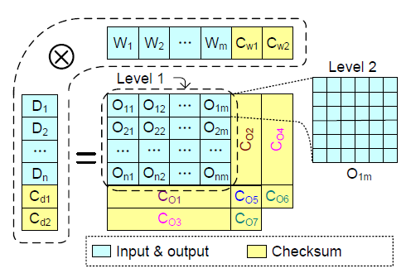
Checksum Support

Slide 13
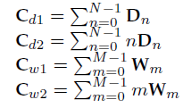
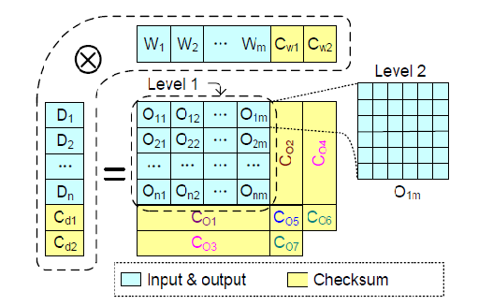
CNN Checksums
Cd1 and Cw1 are calculated before the convolution operation,
Any memory error striking D or W during the convolution would not affect Cd1 or Cw1.

Slide 14
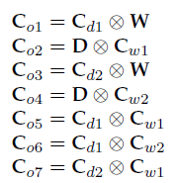
CNN Checksums
The output O is represented in the form of blocks.
Elements inside the same block are
independent with respect to checksums.
perform the checksum comparison independently for each element across blocks.
Multiple soft errors in the same block can be detected and corrected independently.

Slide 15
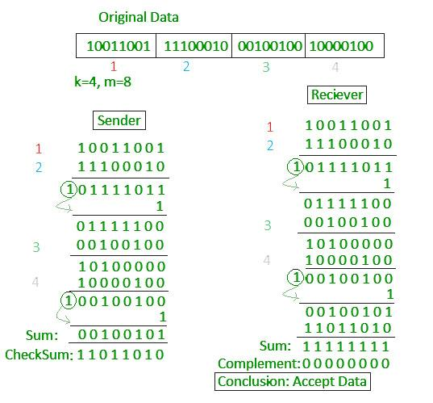
Original Checksum
In checksum error detection scheme, the data is divided into k segments each of m bits.
In the sender’s end the segments are added using 1’s complement arithmetic to get the sum. The sum is complemented to get the checksum.
The checksum segment is sent along with the data segments.
At the receiver’s end, all received segments are added using 1’s complement arithmetic to get the sum. The sum is complemented.
If the result is zero, the received data is accepted; otherwise discarded.

Slide 16
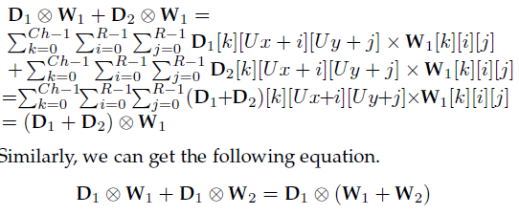
Distributive property of Convolution

Slide 17
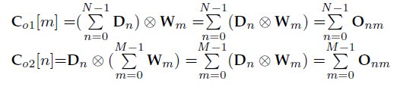
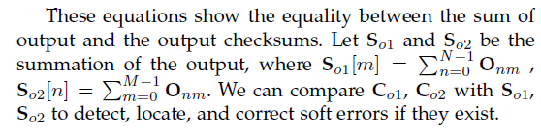

Slide 18
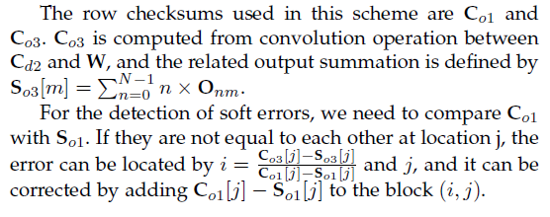
Row Checksum Scheme (RC)

Slide 19
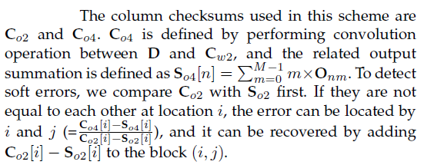
Column Checksum Scheme (ClC)

Slide 20
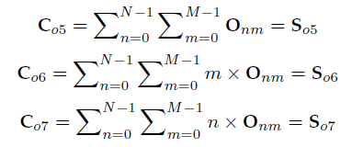
Checksum-of-Checksum Scheme (CoC/CoC-D)
scheme involves neither D nor W but only their checksums, so it is named checksum-of-checksum scheme (or CoC scheme for short).

Slide 21
Analysis of Protection Ability for Convolution Checksum Schemes

Slide 22
Fault Model
Assumptions:
transient faults in computational units
data corruption faults (both transient and persistent) in memory (including cache).
Fault represents a malfunction event, and we denote its corresponding symptom as soft error.
Soft error protection includes error detection and error correction.
Error detection means that the scheme can detect soft errors without knowing the exact location.
Error correction means that the scheme can locate the soft error locations and recover the incorrect result.

Slide 23
Limitation
Without loss of generality, the following analysis considers at most one fault per convolution.
One convolutional neural network contains several or even tens of convolutional layers, and the total forward execution time of a CNN model is usually within seconds.
Thus, we can reasonably assume that at most one fault may strike to one convolutional layer, considering the short executing time of a single layer.
Multiple faults per convolution can also be detected by our schemes and recovered by recomputing the corrupted convolutional layer.

Slide 24
Analysis of Soft Error in D and W
One fault occurring during the convolution execution can result in multiple soft errors in W and D.
The soft errors in W can be detected by comparing the checksum of W with Cw1 and corrected by reloading weights from the CNN model.
The soft errors in D do not need correction because D will be discarded after convolution computation.
The resulting errors in the output can be detected and corrected by the checksums of the output, as demonstrated below.

Slide 25
One fault during the convolution execution can result in corruption of one block row or column of O.
By definition, the row i of O is computed by the ith block of D with W. Thus, one fault in D would result in at most one corrupted row.
The column j of O is computed by D with the jth block of W. Thus, one fault in W would result in at most one corrupted column.
Moreover, the intermediate result will be reused only by the same row or column, such that one fault in the computational units would corrupt only values in the same row or column.
Accordingly, the soft error protection ability in the context of at most one corrupted row or column of O will be decided.

Slide 26
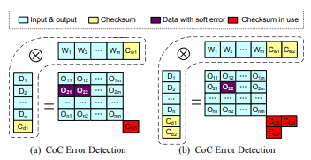
Soft Error Protection Ability of CoC Scheme
When soft errors strike the input or output data:
Multiple soft errors can be detected by using only Co5.

Slide 27
Soft Error Protection Ability of CoC Scheme
When soft errors strike the input or output data:
A single soft error in O can be corrected by CoC using all checksums including Co5, Co6, and Co7, as shown in Figure 2 (b).

Slide 28
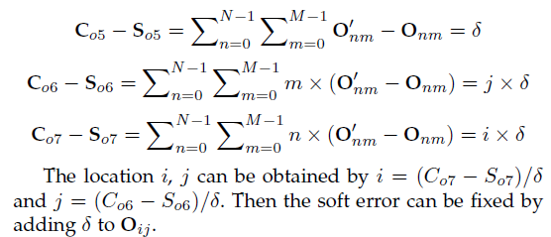
Soft Error Protection Ability of CoC Scheme
When soft errors strike the input or output data:
A single soft error in O can be corrected by CoC using all checksums including Co5, Co6, and Co7.
[CoC cannot correct soft errors across multiple blocks in O.]

Slide 29
Soft Error Protection Ability of CoC Scheme
When soft errors strike the input or output data:
However, CoC cannot correct soft errors across multiple blocks in O.

Slide 30
When checksums are corrupted
Such soft errors can cause inconsistency among the output checksums of CoC, which can be used for error detection.
For example, if Cd1 is corrupted, leading to corrupted Co5 and Co6 with correct Co7.
We can detect this abnormal pattern when comparing checksums with the summation of O to detect the input checksum corruption.
The input D, W, and output O are clean and without soft errors since fault frequency is at most once per convolution. Thus, we can safely discard all the checksums and finish this convolution computation

Slide 31
When checksums are corrupted
Only one of them will be corrupted among Co5, Co6, and Co7
[`One fault during the convolution execution’: Assumption from fault model]

Slide 32
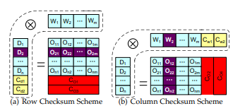
Ability of Row and Column Checksum Scheme
the row checksum scheme and column checksum scheme are symmetric.
the row checksum scheme can detect and correct soft errors if they are in the same row.
If the soft errors are in the same column, the row checksum scheme can only detect soft errors; it has no correction ability.
The column checksum scheme, on the contrary, can detect and correct errors located in the same column but fail to correct those appearing in the same row.

Slide 33
Revisit Row Checksum Scheme (RC)

Slide 34
Revisit Column Checksum Scheme (ClC)

Slide 35
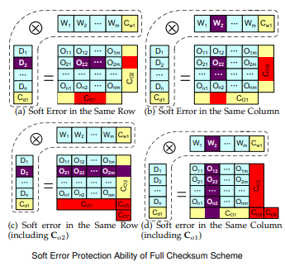
Ability of Full Checksum Scheme
Full checksum scheme has the highest ability to correct soft errors.
The scheme uses both the row checksum Co1 and column checksum Co2 so that it can correct soft errors in both directions.

Slide 36
Ability of four schemes
CoC scheme has the lowest error correction ability and that the full checksum scheme has the best error correction ability.
The abilities of the row checksum scheme and column checksum scheme are higher than that of the CoC scheme but lower than that of the full checksum scheme.
CoC-D can detect multiple soft errors but without correction ability.
The analysis here serves as the fundamental basis of our low-overhead high protection design.

Slide 37
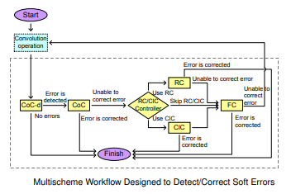
Multischeme Workflow for Soft Error Protection
To achieve the highest protection ability and lowest overhead: multischeme workflow by integrating the four schemes.
use CoC-D to detect errors because it has the lowest overhead.
For the error correction, put CoC in the beginning because it is the most lightweight method.
By comparison, FC has highest correction ability but also highest time overhead, so put it at the end of the workflow.

Slide 38
Soft Error Protection Ability of CoC Scheme
When soft errors strike the input or output data:
A single soft error in O can be corrected by CoC using all checksums including Co5, Co6, and Co7.
[CoC cannot correct soft errors across multiple blocks in O.]

Slide 39
Multischeme Workflow for Soft Error Protection
The error detection modules will be executed for every execution whether there is a soft error or not. Thus, any unnecessary computations should be avoided in order to reduce the overall overhead.
For instance, both CoC-D and FC are able to detect all the soft errors, but we adopt only CoC-D in the workflow for error detection because FC has a much higher overhead. RC and ClC cannot detect soft errors correctly if the checksum is corrupted.

Slide 40
Multischeme Workflow for Soft Error Protection
The error correction module will not be executed until some soft errors are detected. The schemes in this module will be invoked to fix soft errors according to the workflow. If it fails to correct the errors due to inconsistency of checksum blocks or illegal error locations, the next-level scheme will be invoked.

Slide 41
Multischeme Workflow for Soft Error Protection
Checksums can be reused among different CNN schemes in the workflow, the runtime of the workflow is actually lower than the sum of all schemes’ runtimes.
For example, both CoC-D and CoC use Co5; if CoC-D detects soft errors and CoC is invoked to correct soft errors, CoC can save the time of computing Co5 and its corresponding summation So5, since they have been computed by CoC-D.

Slide 42
Code Ref
https://oneapi-src.github.io/oneDNN/v0/index.html
https://github.com/oneapi-src/oneDNN/blob/master/examples/cnn_inference_f32.cpp
https://github.com/oneapi-src/oneDNN/blob/master/examples/cnn_inference_int8.cpp

Slide 43
Assignment
Implement Multischeme Workflow for Soft Error Protection
If soft errors exist in Co1/Co2 (any of them), error detection and correction is still possible.
- Justify or Refute

Slide 44
Ref:
https://www.researchgate.net/publication/348144782_FT-CNN_Algorithm-Based_Fault_Tolerance_for_Convolutional_Neural_Networks

